Slide 1
Object-Oriented Development (CIS1056-N)
ICA Brief, Legal and Security Issues

Slide 2
Introduction
ICA briefing
This lecture will be an introduction to two important areas you need to be aware of as an individual and a professional
Consideration of Security and Legal issues
Huge areas, so we can’t cover everything – a starting point

Slide 3
ICA Briefing

Slide 4
Discussion/Q & A
GAS Java Prototype [70%]
Testing [20%]
Report [10%]

Slide 5
ICA Briefing – GAS Package Prototype
Individual Assessment
Academic Integrity & Malpractice
Plagiarism
Review the ICA documentation
Three parts
Implementation [70%]
Testing [20%]
Report [10%]
Mini-requirements specification
It’s what the client wants!
Devise a test plan as you go along, not at the end
Test to fail!
Before submitting – test on lab computers to ensure everything works
Don’t include absolute or relative file paths that are specific to your computer

Slide 6
Data security and legal issues

Slide 7
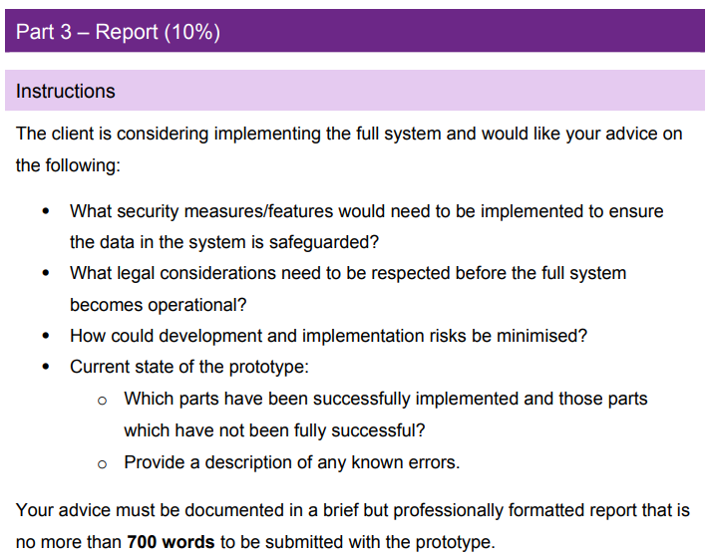
From the ICA brief

Slide 8
Data
In the past few weeks:
When have you given out data about yourself?
Which companies have made use of your data?
What has that data been used for?
Why?

Slide 9
Introduction to Data Protection
The main legislation regarding data protection is the Data Protection Act (2018)
The UK implementation of GDPR
What we will look at:
Why do we need to protect data?
What happens when things go wrong
Your data and rights under the act

Slide 10
What does Facebook know about you?
What ever you want to tell them!
And they keep this data
It includes:
Your sign-up/registration information
Information you share on your timeline
Information others share about you
Information they receive about you:
When you look at another’s timeline
Search for a friend or a page
Make purchases through Facebook
What devices you use Facebook on
If you play a game (or app) that uses Facebook Platform – date and time your visit the site etc.

Slide 11
Look after your Digital Reputation
Potential employers will Google you and look at your Facebook/Twitter/Social media histories
Be very careful of how you portray yourself online
Be mindful of the data trail you leave behind you!
It can have consequences

Slide 12
What they do with this data
Use it to suggest other services or features
If they have your GPS location will make this information location specific
Aggregate and anonymise your data with other peoples’ and provide this to advertising partners and customers
Profiling
Facebook will make money out of this

Slide 13
Data and information has value
Businesses want information about users and they will pay for it
What an organisation does with data must be declared in their registration with the Information Commissioner’s Office (ICO)
And the organisation MUST comply with the Data Protection Principles
Businesses/Organisations face considerable fines if they fail their data management responsibilities

Slide 14
Data Protection Principles
Lawfulness, fairness, and transparency – using personal data in a way that complies with the law, and in a way your customers and staff expect and have been told about.
Purpose limitation – only use personal data for the reasons you collected it, and not for something extra or unrelated.
Data minimisation – limit the amount of personal data you collect to what you need. If you only need basic contact details of your customers to run your accounts, don’t ask for more information.
Accuracy – the personal details in your records should be accurate and kept up to date.

Slide 15
Data Protection Principles (cont.)
Storage limitation – only keep personal data for as long as you need it. When you no longer need it, it should be securely destroyed or deleted.
Integrity and confidentiality (security) – personal data needs to be kept securely. You need to make sure that the details of your staff and customers is protected and that you can access those details.
Accountability – this underpins the other six principles. It’s about taking responsibility, having appropriate measure in place, and keeping records to demonstrate how you achieve data protection compliance. Company owners should hold themselves accountable for getting it right.

Slide 16
What data does a company hold?
You have a legal right to find out
It is called a Subject Access Request (SAR)
After this lecture have a look at the websites of some of the organisations you have just identified and see if you can find out how to make a SAR to them

Slide 17
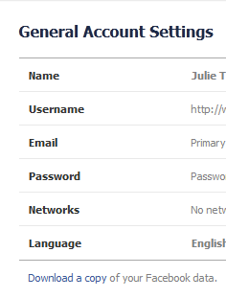
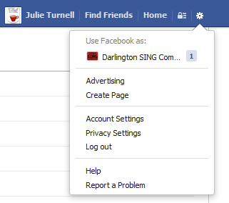
Data
Facebook
Has anyone ever downloaded a copy of their Facebook data?
Did you even know you could?
How to do it:
1
2
3

Slide 18
What happens when things go wrong
“Hacks”
2017 Equifax breach
Rockstar breach leading to leak of GTA 6
Hack of Australian Telecoms company Optus
Data Loss
NHS memory stick found in street
Government Departments data losses
These are just a handful; too many to mention!
Other smaller kinds of breach too…

Slide 19
Consequences
Loss or theft of data is particularly bad
For the victim:
Personal data can be used in identity theft and other fraud
Lost passwords can lead to compromise of other accounts
For the company:
Reputational damage
Cost to investigate, address causes
Fines

Slide 20
Consequences
Under Data Protection act, a company in breach of the act can be fined up to £17.5 million or 4% of the total annual worldwide turnover in the preceding financial year, whichever is higher.
This is rare, but it can happen in the worst cases
A list of the top 30 fines as of May 2022
Amazon fined €746M!

Slide 21
Your duties under the Act as a software developer
Data Protection Principles
Principle 7 particularly important for you:
Appropriate technical and organisational measures shall be taken against unauthorised or unlawful processing of personal data and against accidental loss or destruction of, or damage to, personal data.
Technical measures?
Organisational measures?
Notes:
Technical examples:
Lock away servers etc
Anti-virus & anti-malware
Well configured firewall
Access controls (passwords)
Segmentation of network components (e.g. keeping web and file servers separate)
Encrypted files, USB drives and laptops
Organisational Examples:
Good password policy & enforcement
Monitor and/or control physical access to a building
Staff training and awareness of their duties & responsibilities under the DPA
Restrictions on employees personal use of the system

Slide 22
Your duties as a software developer
If you are working for a client you need to make sure any system you develop makes compliance with the DPA easy for the client
Follow good, professional develop practices (sound methodology, good documentation etc.)
You may also need to advise your client about the DPA, not everyone is aware of it – behaving in a professional manner
Useful Link specifically about principle 7 from ICO

Slide 23
Final words …
In the report: Context - relate the data security and legal issues to the application that you’re developing – not just a general discussion…

